Slide 1

The Healthy Life
[Instructor Name]
[Class and Section Number]
Notes:
This module provides an overview of health psychology, which is a field devoted to understanding the connections between psychology and health. Discussed here are topics including stress, psychosocial factors related to health and disease, how to use psychology to improve health, and the role of psychology in medicine. It is recommended to be taught over two class periods.
Technical Note: These slides may contain simple click animation so that you can focus students’ attention on a particular question, a selection of text, or an image and not have them be distracted by reading ahead. You can either preview the sequence of animation by going through the slides in slideshow view, visiting the animations tab, or reviewing the slide notes. In the notes you will see a cue - (Click) – that corresponds to each animation.
You will also find hyperlinks to outside videos at various places in the slides. These hyperlinks are embedded in text and indicated by color and in the notes section.

Slide 2
Overview
What is Health Psychology?
Stress and Health
Protecting Our Health
The Importance of Good Health Practices
Psychology and Medicine
Being a Health Psychologist
The Future
Notes:
This slide provides an overview of the material that will be covered during the lecture.

Slide 3


What is Health Psychology?
Notes:
This slide begins a discussion of chronic disease and the role that psychological and social factors play within this context. The discussion is intended to emphasize the significant and current importance of Health Psychology.
Lecture Info:
Chronic disease refers to long-term illnesses that can be controlled but not cured. These days chronic disease is at an all-time high, in part because people live longer in general, and also because of our unprecedented access/exposure to unhealthy options. In managing illnesses that persist over time (such as cancer, diabetes, and heart disease—the number one cause of death, worldwide) many psychological factors affect the progression of the ailment. For example:
Do patients seek help when appropriate?
Do they follow doctor recommendations?
Do they develop negative psychological symptoms due to lasting illness (e.g., depression)?
Psychological factors can also play a significant role in who develops these diseases, the prognosis, and the nature of the symptoms related to the illness.
Explanation: Health psychology is a relatively new, interdisciplinary field of study that focuses on the role of psychology in maintaining health, as well as preventing and treating illness. It considers how the choices we make, the behaviors we engage in, and even the emotions that we feel, can play an important role in our overall health. Today, many leading causes of illness in developed countries are attributed to psychological and behavioral factors. For example, in cases of heart disease, excessive stress, smoking, poor eating habits, and certain personality traits can influence risk and significantly impact health outcomes.
That being said, many of these factors can be adjusted using psychological techniques. For example, clinical health psychologists can teach important stress reduction techniques, and treat psychological disorders tied to poor health, as well as promote healthy practices, such as good dietary choices and quitting smoking.

Slide 4
What is Health Psychology?
Biopsychosocial Model: Biology, psychology, and social factors are just as important in the development of disease as biological causes (e.g., germs, viruses ).
Biomedical Model
(old): Prioritizes
biological factors.
Psychology
Biology
Social
Notes:
This slide presents the Biopsychosocial Model, which takes into account how biological, psychological, and social factors interact to impact the development of disease.
Lecture Info:
(Click) Health psychology relies on the Biopsychosocial Model of Health. This model posits that biology, psychology, and social factors are just as important in the development of disease as biological causes (e.g., germs, viruses).
(Click) The Biopsychosocial Model replaces the older Biomedical Model of Health, which prioritizes the physical (pathogenic) factors contributing to illness.
Explanation: Advances in medical technology have revealed physiological underpinnings of the mind–body connection, and in particular, the role that feelings play in our body’s functions. Health psychology researchers working in the fields of psychosomatic medicine and psychoneuroimmunology, for example, are interested in understanding how psychological factors can “get under the skin,” and influence our physiology—in other words, how factors like stress can make us sick.

Slide 5
Overview
What is Health Psychology?
Stress and Health
Protecting Our Health
The Importance of Good Health Practices
Psychology and Medicine
Being a Health Psychologist
The Future
Notes:
This slide provides an overview of the material that will be covered during the lecture.

Slide 6
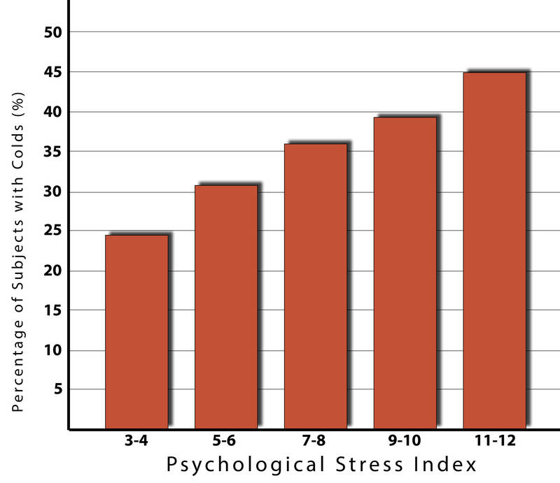
Stress and Health
Notes:
This slide presents a specific example of stress directly influencing health—in this instance, its impact on an individual’s resistance to the common cold.
Warm-up Discussion Questions: Why is chronic stress a significant concern for the health and well-being of human beings? Is stress simply an emotional response that shapes our mood, or is it a physiological response that impacts our body? Does stress necessarily have long-term effects or can it be regulated and managed?
Click the “Stress and Health” hyperlink to play a video demonstrating the mechanics of stress in the animal kingdom (“Why Zebras Don’t Get Ulcers” (3 min.))
Lecture Info:
You might not realize it, but questions like, “How stressed do you feel?” or “How overwhelmed do you feel?” can predict your likelihood of developing both minor illnesses as well as serious problems like future heart attacks. To understand how, health psychologists study the types of associations described in the following famous stress/health study:
In this study, researches exposed test subjects to a cold virus.
They then monitored the subjects’ stress levels over several days, as well as the amount of mucus the subjects produced, and analyzed body fluid samples—all to see if they were objectively ill with a cold. Despite all the subjects being equally exposed to the virus, not everyone came down with the illness.
In fact, as illustrated by the chart, the findings showed that the people who were less stressed and more positive at the beginning of the study were at a decreased risk of developing a cold.

Slide 7


Stress and Health
Major Life Stressors Daily Hassles
Notes:
This slide presents some causes of stress—specifically, major life stressors (e.g., hurricanes/natural disasters) and small daily hassles (e.g., traffic), and how they influence your physical health/immune system.
Lecture Info:
It’s not just major life stressors (e.g., a death in the family, natural disasters) that increase the likelihood of getting sick. Even minor hassles like traffic and arguing can raise your blood pressure, alter your stress hormones, and even suppress your immune system. It has become clear that stress plays a major role in both our mental and physical health, but what exactly is it?
Explanation: The word “stress” was first used in a psychological context by researcher Hans Selye, who discovered that rats in his lab were suffering negative health outcomes, such as ulcers, from being handled by researchers. Selye (1946) coined the term “stressor” to label stimuli that cause such aversive experiences of high physical arousal, and he developed a model of the stress response called the General Adaptation Syndrome (GAS). The GAS is described as three phases of response to stress:
Mobilization of physiological resources (alarm, fight-or-flight)
Coping (resistance and/or attempted habituation)
Recovery/Exhaustion (the organism either recovers or depletes its physiological resources in the process)
Further Explanation: Since Selye’s discovery, psychologists have studied stress in a myriad of ways, including stress resulting from negative events (e.g., natural disasters), chronically difficult situations (e.g., taking care of a loved one with Alzheimer’s), short-term hassles, biological fight-or-flight responses, and even clinical illnesses like post-traumatic stress disorder (PTSD). The GAS continues to be one of the most important and well-studied psychological correlates of illness, because excessive stress causes potentially damaging wear-and-tear on the body and can influence almost any imaginable disease process.

Slide 8
Overview
What is Health Psychology?
Stress and Health
Protecting Our Health
The Importance of Good Health Practices
Psychology and Medicine
Being a Health Psychologist
The Future
Notes:
This slide provides an overview of the material that will be covered during the lecture.

Slide 9


Protecting Our Health: _x000b_Coping Strategies
Problem-Focused Emotion-Focused
Notes:
This slide begins a discussion regarding coping strategies to protect our own health.
Lecture Info:
Coping is often classified into two categories: problem-focused coping or emotion-focused coping:
Problem-focused coping involves actively addressing the stressor to solve the issue. For example, say an important exam is coming up next week; a problem-focused strategy might be to spend additional time studying over the weekend.
Emotion-focused coping, on the other hand, regulates the emotions that come with stress. For example, an approach to alleviating the stress caused by the upcoming exam might be to watch a funny movie—taking your mind off the problem.
In the short term, emotion-focused coping might reduce feelings of stress, but problem-focused coping tends to have the greatest impact on mental wellness. That being said, when events are uncontrollable (e.g., the death of a loved one), emotion-focused coping directed at managing your feelings might be the best initial strategy. It is always important to consider the appropriateness of the match of the stressor to the coping strategy when evaluating its plausible benefits.
Discussion Prompt: Click the “Protecting Our Health: Coping Strategies” hyperlink to play a brief video demonstrating a humorous example of coping (“It’s Not About the Nail” (2 min.))
Follow-up Questions: What coping strategy was being depicted in the video? What is a recent stressor in your life and what are some ways you dealt or coped with it?
Optional In-Class Activity: How Do You Cope With Stress? (For detailed instructions see IM > Unit: Psychological Health > Module 2: The Healthy Life > Activities/Demonstrations.)
Time: 20 min
Materials: Handouts of Moos and Halahan’s coping survey

Slide 10
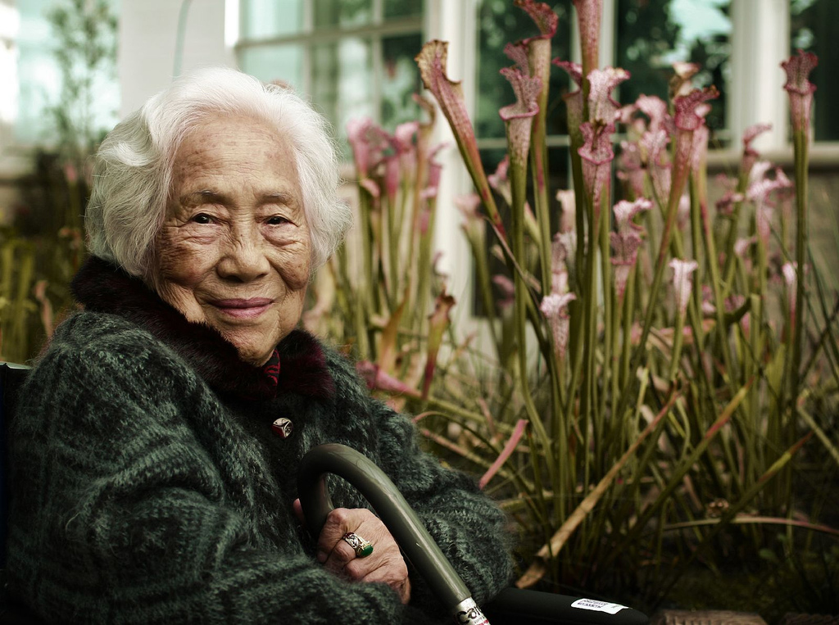

Protecting Our Health:
Control and Self-Efficacy
Control Belief Self-Efficacy
Notes:
This slide proposes two related ways individuals might improve their own health: increasing their sense of control and self-efficacy.
Lecture Info:
Another factor tied to better health outcomes and improved coping ability is believing that one has control over a situation.
For example:
In one study participants were forced to listen to stressful noise; those who believed they had control over the noise performed much better on proofreading tasks afterwards. Even though none of the participants had actual control over the noise, the control belief aided them in completing the task.
Studies have also shown that elderly residents in assisted living facilities lived longer and showed better health outcomes when given control over something as simple as watering a plant or choosing when volunteers visited.
In similar studies, perceived control has been shown to benefit immune system functioning and to lower stress hormone levels. Believing that you have control over your own behaviors can also have a positive influence on important outcomes like smoking cessation, contraception use, and weight management. Conversely, when individuals do not believe they have control, they do not try to change.
Further Explanation: Self-efficacy is the belief that one can perform adequately in a given situation. It is closely related to control, in that people with high self-efficacy believe they can complete their goals, thus reducing stress, improving health, and avoiding negative health behaviors.
Instructor’s Note: It’s important to emphasize that actual control is not necessary, but rather the perception of control that is most relevant to protecting health.

Slide 11

Protecting Our Health:
Social Relationships
Social Integration
  Daughter
  Student
  Team member
Social Support
  Emotional
  Tangible
  Advice
Notes:
This slide explores the health benefits of social support and the negative effects of social isolation.
Discussion Questions: Can loneliness or isolation influence our health? Would you expect two people with the same high-stress job to be equally healthy if one was the member of a large family and social group, and the other had no family in town and few friends? In what ways might one’s relationships or lack thereof contribute to his or her physical health and health behaviors?
Lecture Info:
The importance of social relationships for our health is so significant, some scientists believe the human body has developed a physiological system that promotes seeking out relationships—especially in times of stress. In fact, research has shown that the impact of social isolation is similar in magnitude to the health risks associated with smoking.
(Click) Social Integration
Social integration is the concept that describes the range of a person’s social roles, as well as his or her sociability. A person can have multiple roles (e.g., daughter, coworker, student, basketball team member); maintaining these different roles can help promote a healthy lifestyle via positive reinforcement from one’s community.
(Click) Social Support
Those in one’s social network might also provide crucial social support during times of stress, in the form of emotional comfort (e.g., a hug or pep talk), tangible help (e.g., a loan or place to stay), or advice. By encouraging healthy behaviors and reducing stress, social relationships can have a powerful, protective impact on health to such an extent that they might even help people with serious illnesses live longer.
Optional In-Class Activity: Examining Our Social Networks (For detailed instructions see IM > Unit: Psychological Health > Module 2: The Healthy Life > Activities/Demonstrations.)
Time: 10 – 15 min
Materials: None

Slide 12
Protecting Our Health:
Dispositions and Emotions
Positive Affect
Stress
Healthy Behaviors
Psychological Activation
Disease
Notes:
This slide presents Type A vs. Type B behaviors and the influences they have on health. Pictured is a diagram (adapted from the unit) illustrating how positive emotions and health behaviors might help to prevent disease.
Lecture Info:
In the 1950s, two cardiologists discovered that certain behavioral and psychological patterns were prevalent among their heart patients and not in others. These patterns—often associated with “negative” dispositions—included competitiveness, impatience, hostility, and time-urgency. The doctors classified these personality traits as Type A Behavior, which they found to be associated with double the risk of heart disease as compared with Type B Behavior (the absence of Type A traits).
Since the 1950s, researchers have found that hostility and competitiveness are especially harmful to heart health. Hostile individuals are quick to upset, and the resulting rage can damage the arteries of the heart. Additionally, given their disagreeable personality style, hostile people often lack a heath-protective supportive social network.
“Positive” traits and states, on the other hand, are often health-protective. As discussed previously, positive emotions and outlooks have been tied to a wide range of benefits, such as increased longevity, reduced likelihood of developing illnesses, and better outcomes following diagnoses. This holds true even in the most poor and underdeveloped nations. As illustrated in the diagram, positive emotions can also serve as “antidotes” to stress, protecting us against some of its damaging effects. Optimism has been shown to improve coping, reduce stress, and predict better disease outcomes, such as recovering from a heart attack more rapidly.

Slide 13
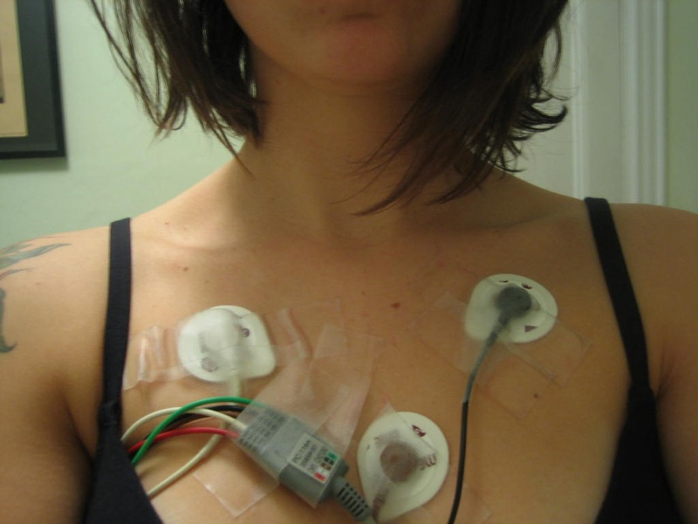
Protecting Our Health:
Stress Management
Biofeedback
Notes:
This slide defines biofeedback and discusses ways in which managing our physiological responses to stress can have significant benefits.
Lecture Info:
About 20 percent of Americans report having stress, with 18–33 year-olds reporting the highest levels. Since the sources of our stress are often difficult to change (e.g., personal finances, current job), interventions have been designed to help reduce the aversive responses to duress. For example:
Relaxation activities and forms of meditation allow individuals to reduce their stress via breathing exercises, muscle relaxation, and mental imagery.
Physiological arousal from stress (e.g., elevated heart rate) can also be managed via biofeedback, a technique where the individual is shown bodily information normally unavailable to them (e.g., heart rate), and then taught strategies to manage the physiological response. This type of intervention has shown promise in reducing heart and hypertension risk, as well as other serious conditions.

Slide 14
Overview
What is Health Psychology?
Stress and Health
Protecting Our Health
The Importance of Good Health Practices
Psychology and Medicine
Being a Health Psychologist
The Future
Notes:
This slide provides an overview of the material that will be covered during the lecture.

Slide 15
The Importance of Good Health Practices
Good
Grades
Pick Two
(Welcome to College)
Social
Life
Enough
Sleep
Notes:
This slide addresses the importance of health behaviors in relation to other, seemingly unrelated outcomes (e.g., school or job performance).
Lecture Info:
The slide illustrates a joke about college life: you can only achieve two of the things shown in the diagram and must sacrifice the third. The busy life of a college student doesn’t always allow one to maintain all three areas of life, especially during test-taking periods—and to push those limits has negative health repercussions. Given the frequency of exposure to the illnesses of fellow students (in lecture halls, cafeterias, and dorms), positive health practices are especially important in times of high stress when one’s immune system is compromised.
In one study, researchers found that students preparing for exams were exceptionally stressed, and thus smoked more, drank more caffeine, were less physically active, and had poor sleep habits, all of which tend to have detrimental health outcomes. Additionally, health behaviors can also influence academic performance. For example, poor sleep quality and quantity relate to weaker learning capacity and academic performance.
Explanation: Psychologists study both health behaviors and health habits. Some examples of health behaviors include:
Positive: regular exercise, flossing, wearing sunscreen
Negative: drunk driving, pulling all-nighters, smoking
Behaviors become habits when they are firmly established and performed automatically (such as putting on a seatbelt without thinking about it). Studies have shown that subjects who engaged in more “protective” habits (e.g., getting 7–8 hours of sleep regularly, not smoking or drinking excessively, exercising) had fewer illnesses, felt better, and were less likely to die over a 9–12-year follow-up period.
Further Explanation: Psychologists put much effort into understanding how to change negative health behaviors, and to understand why individuals fail to act in healthy ways. Health promotion involves enabling individuals to improve their health by enlightening them to what behaviors pose a strong risk for illness and what risk factors are already present. These might be genetic risks or something that developed over time, such as obesity—which puts a person at risk for Type 2 diabetes and heart disease, among other illnesses.

Slide 16
Overview
What is Health Psychology?
Stress and Health
Protecting Our Health
The Importance of Good Health Practices
Psychology and Medicine
Being a Health Psychologist
The Future
Notes:
This slide provides an overview of the material that will be covered during the lecture.

Slide 17
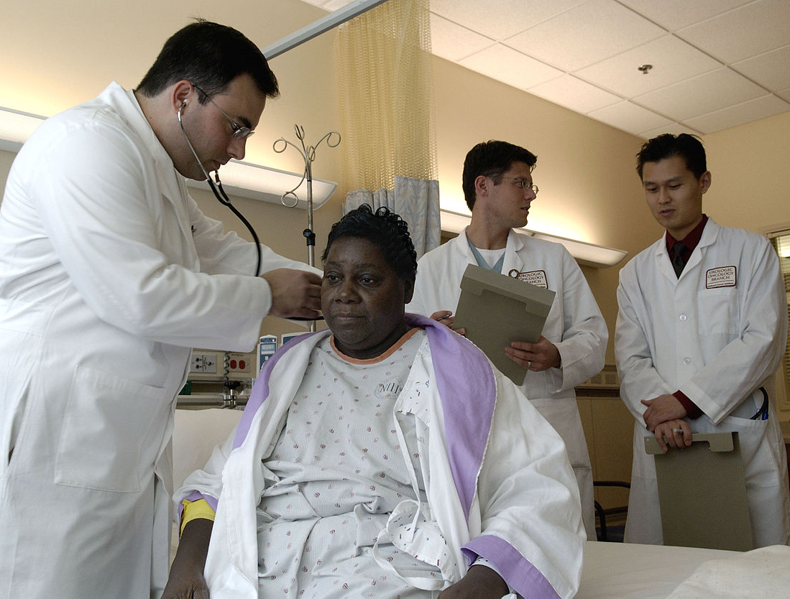
Psychology and Medicine
Psychological Factors -> Treatment Seeking
  Age
  Gender
  Socioeconomic Status
  Stigma
  Communication
  Adherence
Notes:
This slide reviews various psychological and social factors that influence an individual’s ability and/or willingness to seek treatment and to maintain positive health behaviors following treatment.
Discussion Question: What are some reasons people might avoid seeking medical treatment?
Answers students generate might include: they don’t have insurance, they don’t know they’re sick, they don’t trust doctors, they figure they’ll just get over it, they might not take the problem seriously or think it’s just in their head.
Lecture Info:
There are many psychological factors that influence medical treatment outcomes and even the pursuit of treatment.
(Click) Age/Gender/Socioeconomic Status
Older individuals, women, and people from higher socioeconomic backgrounds are all more likely to seek medical care.
(Click) Stigma
On the other hand, some individuals who need care might avoid it, due to financial obstacles or preconceived notions about medical practitioners or the illness itself.
(Click) Communication
The internet has greatly improved people’s access to medical/health information. In 2009, 38% percent of people polled reported that online information influenced their decision to see a doctor. Unfortunately, individuals often do a poor job of assessing the credibility of online health information. For example:
In one study, college-student participants reading online articles about HIV and syphilis rated a physician’s article and a college student’s article as equally credible.
Furthermore, credibility has been shown to be influenced by irrelevant factors, such as the website’s design, logo, or the organization’s contact information.
Similarly, many people post health questions on unmoderated online forums where anyone can respond, allowing unqualified individuals to provide dubious advice about serious medical conditions.
Poor direct communication to medical providers (e.g., due to embarrassment) can also be a major factor in influencing the accuracy of diagnoses and effectiveness of treatment. Oftentimes patients simply don’t tell the whole story, for a variety of reasons—such as feeling rushed or that their concerns are irrelevant or foolish.
(Click) Adherence
After visiting the doctor, not everyone adheres to medical recommendations (e.g., using medications appropriately, losing weight, quitting smoking). Unfortunately, getting patients to follow medical orders is not as easy as one would think.
For example, in one study, over one third of diabetic patients failed to get proper medical care that would prevent or slow down diabetes-related blindness.
Fortunately, as mobile technology has improved, new opportunities have become available for physicians to monitor adherence and work to improve it (e.g., text messaging, and “smart” pill bottles that signal when they are opened).

Slide 18
Overview
What is Health Psychology?
Stress and Health
Protecting Our Health
The Importance of Good Health Practices
Psychology and Medicine
Being a Health Psychologist
The Future
Notes:
This slide provides an overview of the material that will be covered during the lecture.

Slide 19
Being a Health Psychologist
Teams
  Physicians
  Social workers
  Affiliates
  Religious leaders
Clinical Health Psychologists
  Hospitals
  Primary care
  urgent care
  Chronic illness centers
  Rehab centers
Research Health Psychologists
  Universities
  Public health
  Hospitals
  Private organizations
Behavioral Medicine: OT, rehab, preventative med
Notes:
This slide discusses the various roles that might be served by a Health Psychologist, including various occupational goals, job descriptions, and work environments.
Lecture Info:
These days, health psychology is widely represented across medical/scientific research settings.
(Click) Clinical Health Psychologists
Clinical health psychologists can be found in many clinical settings, including hospitals, primary care offices, urgent care centers, chronic illness clinics, and rehabilitation centers.
(Click) Teams
They often work with teams of physicians, social workers, affiliated health professionals, and even religious leaders. While each setting poses its own unique challenges in patient care, the primary responsibilities are the same: Clinical health psychologists evaluate physical, personal, and environmental factors contributing to illness, then form treatment strategies focused on promoting healthy behaviors in all dimensions of patients’ lifestyles.
(Click) Research Health Psychologists
Health psychologists also conduct research to discover new health predictors and risk factors, or develop interventions to prevent and treat illness. Researchers studying health psychology work in numerous academic locations, such as universities, public health departments, hospitals, and private organizations.
(Click) Behavioral Medicine
In the related field of behavioral medicine, careers focus on the application of this type of research—in fields such as occupational therapy, rehabilitation, or preventative medicine.

Slide 20
Overview
What is Health Psychology?
Stress and Health
Protecting Our Health
The Importance of Good Health Practices
Psychology and Medicine
Being a Health Psychologist
The Future
Notes:
This slide provides an overview of the material that will be covered during the lecture.

Slide 21
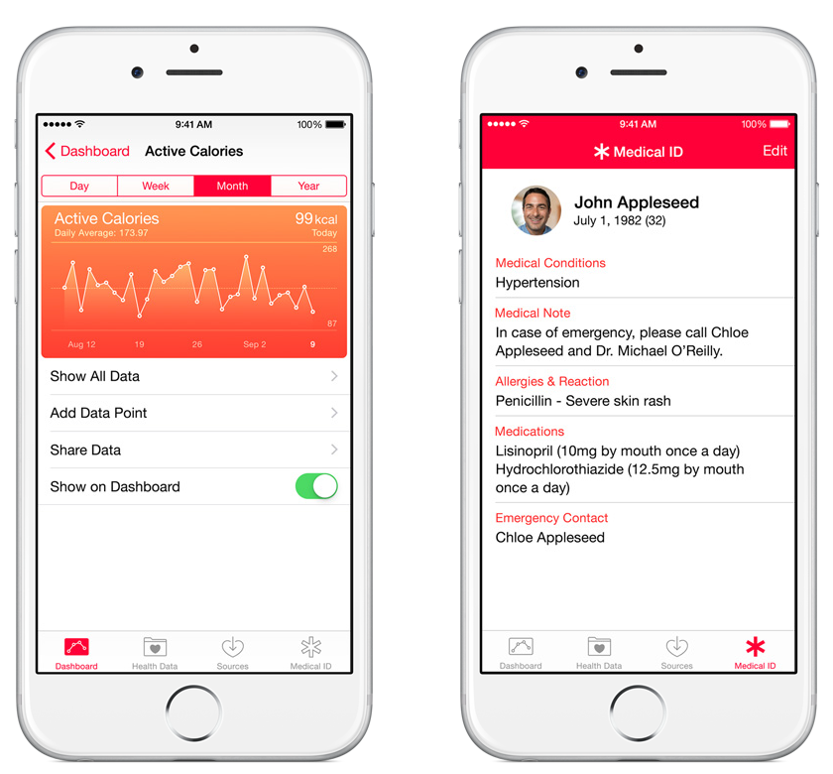
The Future
Prevention
Resilience
Technology
Notes:
This slide concludes the lecture, and explores the anticipated next steps for Health Psychology: increased focus on prevention, increased focus on resilience (protective factors), and greater reliance on technology to improve treatment seeking, retention, and compliance. Pictured is a smartphone app used to monitor and store an individual’s health data.
Lecture Info:
Until recently, western medicine has generally equated “health care” with “illness care”—that is, it has focused almost entirely on the management of symptoms and illnesses as they arise, rather than on root causes. As a result, in many developed countries, we are faced with health epidemics that are difficult and costly to treat, such as obesity, diabetes, and cardiovascular disease.
(Click) Prevention
These days, researchers have begun use the knowledge we have about risk factors to design effective interventions to reduce the prevalence of preventable illness. Additionally, with growing numbers of individuals across developed countries with multiple chronic illnesses and/or lasting disabilities, there is a growing need for skilled individuals who understand how to properly treat these populations. Health psychologists will be at the forefront of such efforts.
(Click) Resilience
It is important that health psychologists move beyond focusing on risk factors (e.g., stress, hostility) in isolation, and concentrate more on factors that confer resilience and protection from disease, such as those discussed in this module and the previous module. Fortunately, there is growing interest in studying the positive factors that protect our health; Seligman (2008) has even proposed a field of “Positive Health” to specifically study those who exhibit “above average” health and perhaps glean some applicable insights from their processes.
(Click) Technology
Recent advances in consumer technology have vastly contributed to possibilities for improving health. For example, we now have mobile (m-health) apps that send reminders to take medication and allow us to monitor our exercise levels, food intake, and physiological conditions. These can be used to raise health awareness, support treatment and compliance, and remotely collect data on a variety of outcomes. Such advancements in technology, partnered with advances in neuroscience and genetic research, are leading health researchers and practitioners into an exciting new era of public health awareness.

Slide 22
Photo Attribution
Slide 1 | Photo Credit: Betty Nudler Photo By http://www.flickr.com/photos/83609144@N07/9585762338/ http://creativecommons.org/licenses/by/3.0/
Slide 3 | Photo Credit: Christian Cable http://www.flickr.com/photos/67287915@N00/282678968 https://creativecommons.org/licenses/by/2.0/
Slide 3 | Photo Credit: Oxfordian Kissuth http://commons.wikimedia.org/wiki/File:Woman_smoking_a_cigarette.jpg http://creativecommons.org/licenses/by-sa/3.0/deed.en
Slide 7 | Photo Credit: NOAA / Satellite and Information Service http://commons.wikimedia.org/wiki/File:Hurricane_Hugo_1989_sept_21_1844Z.jpg http://en.wikipedia.org/wiki/public_domain
Slide 7 | Photo Credit: Minesweeper http://commons.wikimedia.org/wiki/File:I-80_Eastshore_Fwy.jpg http://creativecommons.org/licenses/by-sa/3.0/deed.en
Slide 9 | Photo Credit: wvs https://www.flickr.com/photos/78436447@N00/3833148925/ https://creativecommons.org/licenses/by-nc/2.0/
Slide 9 | Photo Credit:mer chau https://www.flickr.com/photos/64064015@N02/8548057127/ https://creativecommons.org/licenses/by/2.0/
Slide 10 | Photo Credit: MIKELIKEBIKE https://www.flickr.com/photos/47619172@N00/317683194/ https://creativecommons.org/licenses/by-nc-nd/2.0/
Slide 11 | Photo Credit: michael_swan https://www.flickr.com/photos/15731869@N05/13984340136/ https://creativecommons.org/licenses/by-nd/2.0/
Slide 13 | Photo Credit: commoncourtesy https://www.flickr.com/photos/13185589@N00/2656232676/ https://creativecommons.org/licenses/by-nc-sa/2.0/

